Slide 1
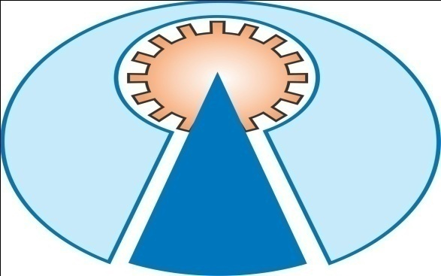
ARRDEKTA INSTITUTE OF TECHNOLOGY
♦ GUIDED BY
♦ Prof. D.R.PATE
Asst.prof in electrical
Department
PREPARED BY
RATHOD VISHANU.
(130930109028)
SONI JAY.
(130930109036)
UPADHYAY MOHIT
(130930109039)
YADHV MUNESH
(130930109040)

Slide 2
THREE PHASE TRANSFORMERS

Slide 3
THREE PHASE SYSTEM
BASICS
Line voltage VL= voltage between lines
Phase voltage Vph= voltage between a line and neutral

Slide 4
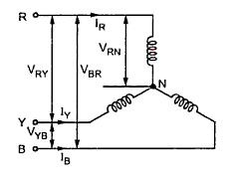
THREE PHASE SYSTEM
BALANCED STAR
Line Voltage,
VL=√3Vph
Line current, IL = Iph

Slide 5
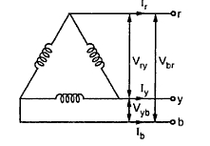
THREE PHASE SYSTEM
BALANCED DELTA
Line Voltage VL= Vph
Line current IL = √3 Iph

Slide 6
THREE PHASE TRANSFORMERS
Almost all major generation & Distribution Systems in the world are three phase ac systems
Three phase transformers play an important role in these systems
3 phase transformers can be constructed from
3 single phase transformers
(b) 2 single phase transformers
(c ) using a common core for three phase windings

Slide 7
3 phase Transformer connections
By connecting three single phase transformers
Star- Star connection
Delta- Delta connection
Star – Delta connection
Delta – Star connection

Slide 8
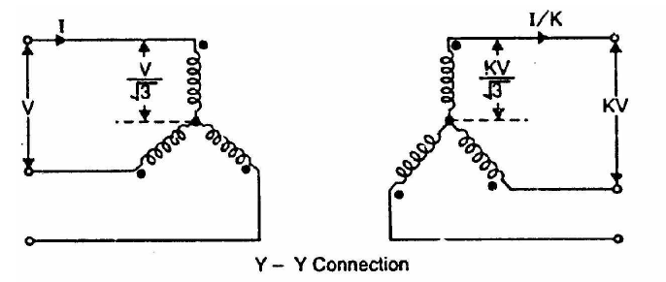
Star- Star connection
This connection satisfactory only in balanced load otherwise neutral point will be shifted.

Slide 9
Star- Star connection
Advantages
1.Requires less turns per winding i.e. cheaper
Phase voltage is 1/√3 times of line voltage
2.Cross section of winding is large i.e. stronger to
bear stress during short circuit
Line current is equal to phase current
3. Less dielectric strength in insulating materials
phase voltage is less

Slide 10
Star- Star connection
Disadvantages
1.If the load on the secondary side unbalanced
then the shifting of neutral point is possible
2.The third harmonic present in the alternator
voltage may appear on the secondary side. This
causes distortion in the secondary phase
voltages
3. Magnetizing current of transformer has 3rd
harmonic component

Slide 11
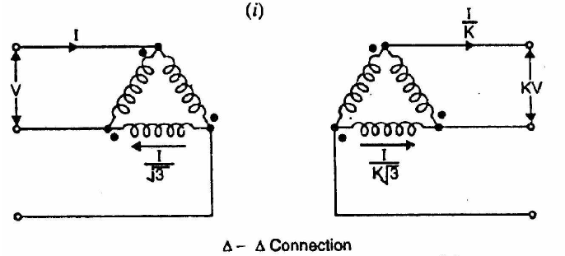
Delta - Delta connection
This connection is used for moderate voltages

Slide 12
Delta - Delta connection
Advantages
1. System voltages are more stable in relation to
unbalanced load
2. If one t/f is failed it may be used for low power
level i.e. V-V connection
3. No distortion of flux i.e. 3rd harmonic current not
flowing to the line wire

Slide 13
Delta - Delta connection
Disadvantages
1.Compare to Y-Y require more insulation.
2. Absence of star point i.e. fault may severe.

Slide 14
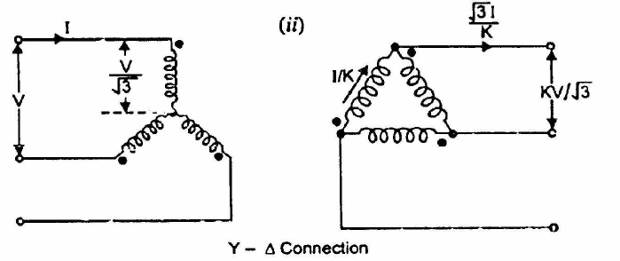
Star- Delta connection
Used to step down voltage i.e. end of transmission line

Slide 15
Star- Delta connection
Advantages
The primary side is star connected. Hence fewer number of turns are required. This makes the connection economical
The neutral available on the primary can be earthed to avoid distortion.
Large unbalanced loads can be handled satisfactory.

Slide 16
Star- Delta connection
Disadvantages
The secondary voltage is not in phase with the primary. (30 ⁰ phase difference )
Hence it is not possible to operate this connection in parallel with star-star or delta-delta connected transformer.

Slide 17
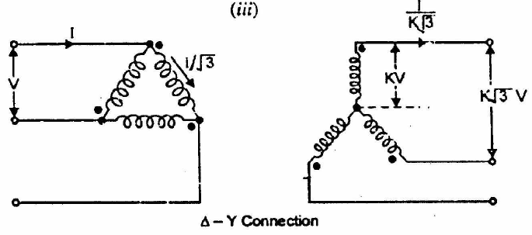
Delta - Star connection
This connection is used to step up voltage ie. Beginning of high tension line

Slide 18
Delta - Star connection
Features
secondary Phase voltage is 1/√3 times of line voltage.
neutral in secondary can be grounded for 3 phase 4 wire system.
Neutral shifting and 3rd harmonics are there.
Phase shift of 30⁰ between secondary and primary currents and voltages.

Slide 19
THANK YOU

